Slide 1
DSE ZG523 Introduction to Data Science
Lecture – 14
Sumita Narang

Slide 2
Objectives
Storytelling with Data
• The final deliverable
• The Narrative - report / presentation structure
• Building narrative with Data
• Effective storytelling

Slide 3
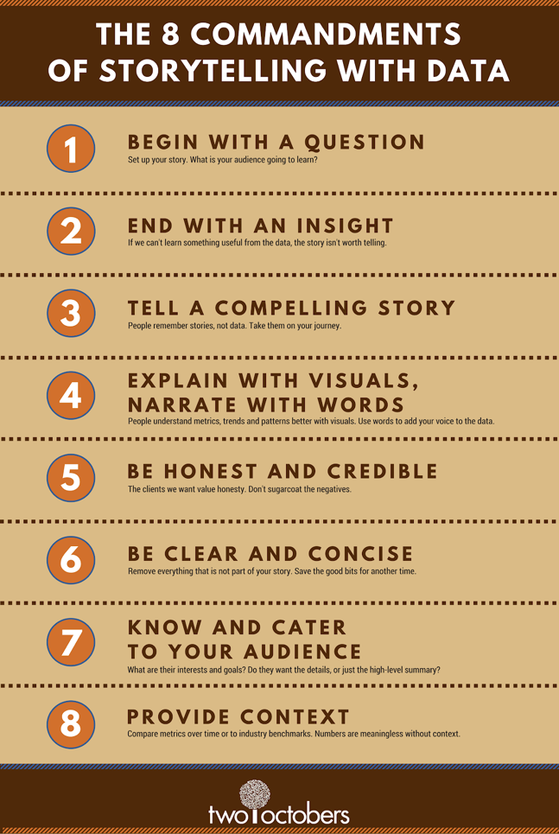
The 8 Commandments of Data Storytelling

Slide 4
Story Definition and Model
Story
ordered sequence of steps (<- order is key) each step contains text, images, visualizations, video, etc.
defined path (or paths) through the steps
Journalism Model
journalists collect information through research, interviews, etc. to assemble the key facts
tie together the key facts (raw material) to produce a story
Data Analyst Model
use visualization for exploration and analysis
use visualization for presentation (storytelling) using the results from the analysis
tools used for analysis may not work for presentation

Slide 5
Telling the Right Story –
Telling the Story Right
A well designed visualization:
– Gives an immediate and profound impression
– Cuts through the clutter of data complexity
Process:
1. Decide what the story is – define your objective
What are the business points you are trying to make?
2. Determine what data to include and exclude
What data is going to make your point?
3. Design visualizations to convey a meaning
What is the best chart to show your point with that data?

Slide 6



Characterizing the Area −Narrative Visualization
Narrative framework
visual structure (genre): support the story
interactivity: engage the story
messaging: tell the story
Approaches
author driven: strong ordering, heavy messaging, limited interactivity
reader driven: weak ordering, light messaging, free interactivity
Common schemas
martini glass structure: prioritizes author-driven approach
drill-down story: prioritizes reader-driven approach
interactive slide-show: promotes dialog between above approaches

Slide 7
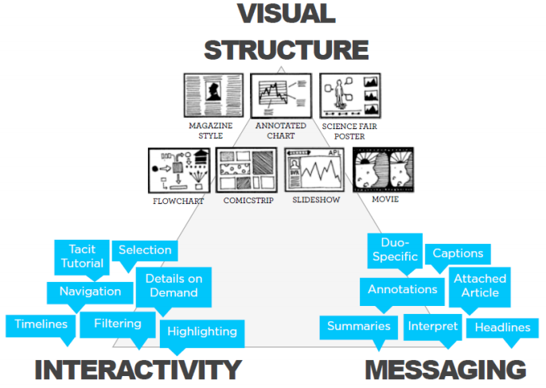
Narrative Framework

Slide 8
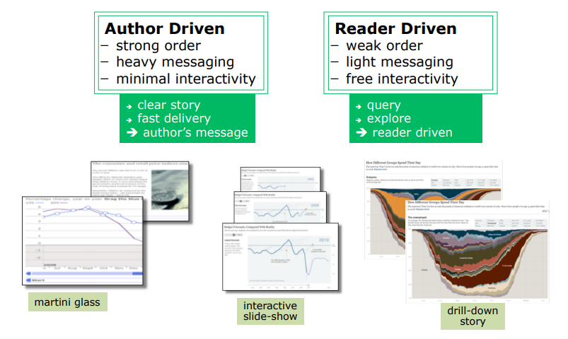
Design Space … genres + interactivity + messaging

Slide 9
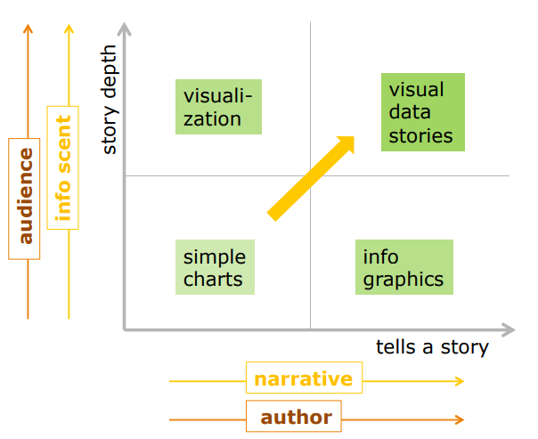
Storytelling elements

Slide 10
Use Brain Rule No. 5 – Attention
To Create Great Presentations
10 minute each session
or 20 minutes = 2 X 10 minute sessions
PowerPoint slides as props
3 minutes per slide

Slide 11
What’s in a title?
McKinsey: A better way to title charts
Are you using the title of the chart to make your point, to tell your story?
Did you use the McKinsey method of titling to best advantage?
Are you using direct labeling rather than legends where appropriate?

Slide 12
Use Signaling Theory
Research findings tell us that people learn better when material is organized with clear outlines and headings
The Signaling Effect.
Instead of writing a Title, write a Headline that explains the main idea of the chart
Tells your story – makes your point
Just as in newspapers, write your headlines in active voice, with a subject and verb.
Summarize the single overriding idea of the slide in clear and conversational language.
One technique to practice headlines is to look at your slide, then turn to someone else and tell them the main idea of the slide.
That’s your headline

Slide 13
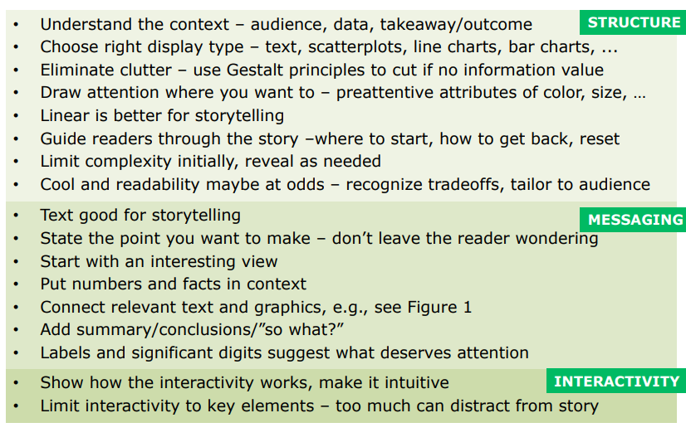
Summary

Slide 14
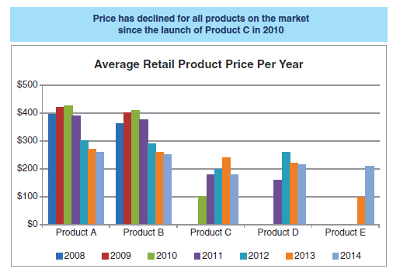

Case Studies – Example 1

Slide 15
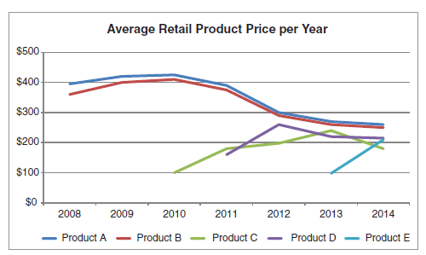
Case Studies – Example 1 Contd..
Lesson 1: understand the context
If we pause to consider specifically the who, what, and how, let’s assume following:
Who: VP of Product, the primary decision maker in establishing our product’s price.
What: Understand how competitors’ pricing has changed over time and recommend a price range.
How: Show average retail price over time for Products A, B, C, D, and E.
Lesson 2: choose an appropriate display
First, let’s remove the visual obstacle of the variance in color. Since the emphasis in the original headline was on what happened since Product C was launched in 2010, let’s highlight the relevant pieces of data to make it easier to focus our attention there for a moment.

Slide 16
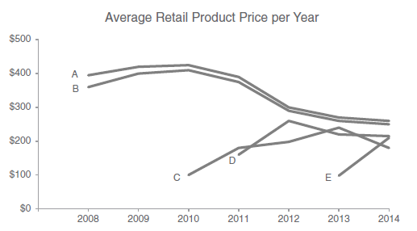
Case Studies – Example 1 Contd..
Lesson 3: eliminate clutter
We can improve this with the following changes:
De‐emphasize the chart title. It needs to be present, but doesn’t need to attract as much attention as it does when written in bold black.
Remove chart border and gridlines, which take up space without adding much value. Don’t let unnecessary elements distract from your data!
Push the x‐ and y‐axis lines and labels to the background by making them grey. They shouldn’t compete visually with the data. Modify the x‐axis tick marks so they align with the data points.
Remove the variance in colors between the various lines. We can use color more strategically, which we’ll discuss further momentarily.
Label the lines directly, eliminating the work of going back and forth between the legend and the data to understand what is being shown

Slide 17
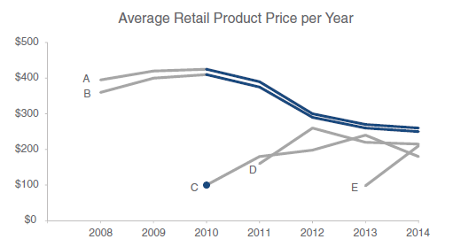
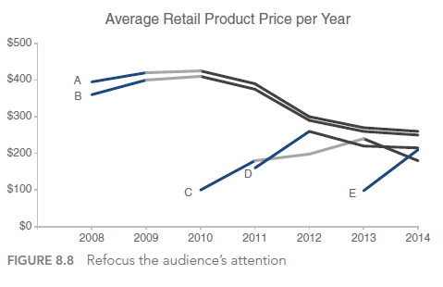
Case Studies – Example 1 Contd..
Lesson 4: draw attention where you want your audience to focus
Consider the initial headline: “Price has declined for all products on the market since the launch of Product C in 2010.” Upon a closer look at the data, I might modify it to say something like, “After the launch of Product C in 2010, the average retail price of existing products declined.”
We can use this same view and strategy to concentrate on another observation—one perhaps more interesting and noteworthy: “With the launch of a new product in this space, it is typical to see an initial average retail price increase, followed by a decline.”

Slide 18
Case Studies – Example 1 How to tell a story..
In the next 5 minutes...
OUR GOAL:
Understand how prices have changed over time in the competitive landscape.
Use this knowledge to inform the pricing of our product.
We will end with a specific recommendation.

Slide 19
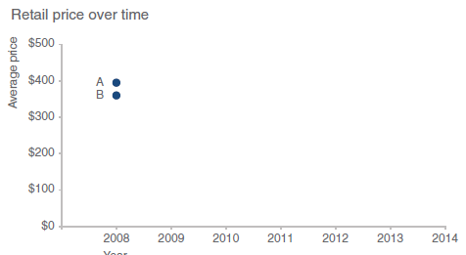
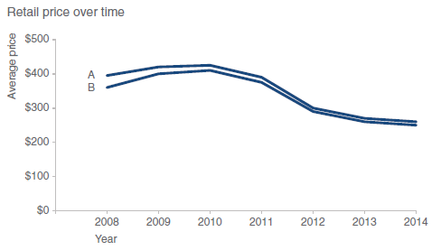
Telling Story with Data
Products A and B were launched in 2008 at price points of $360+
They have been priced similarly over time, with B consistently slightly lower than A

Slide 20
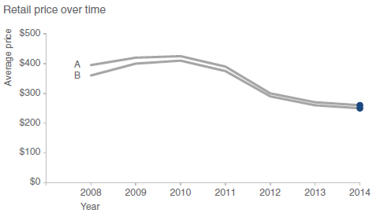
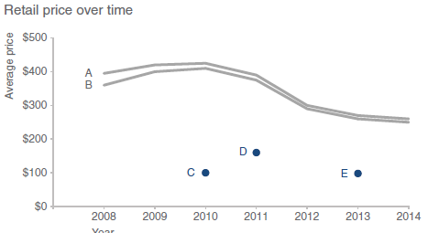
Story with Data contd..
In 2014, Products A and B were priced at $260 and $250, respectively
Products C, D, and E were each introduced later at much lower price points...

Slide 21
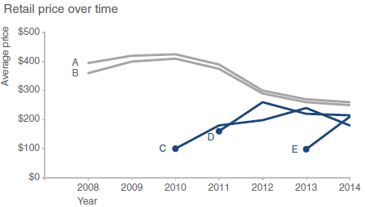
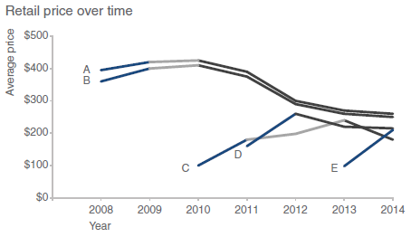
Story with Data contd..
…but all have increased in price since their respective launches
In fact, with the launch of a new product in this space, we tend to see an initial price increase, followed by a decrease over time

Slide 22
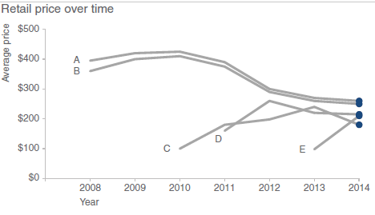
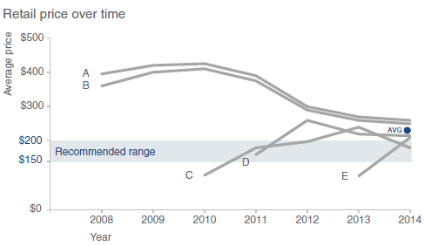
Story with Data contd..
As of 2014, retail prices have converged, with an average retail price of $223, ranging from a low of $180 (C) to a high of $260 (A)
To be competitive, we recommend introducing our product below the $223 average price point in the $150−$200 range

Slide 23
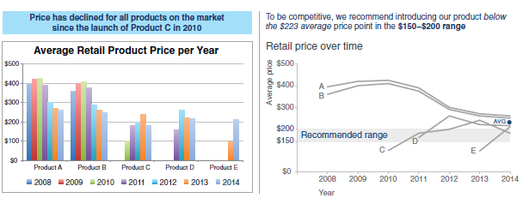
In Closing
Through this example, we’ve seen the storytelling with data process from start to finish. We began by building a robust understanding of the context. We chose an appropriate visual display. We identified and eliminated clutter. We used pre-attentive attributes to draw our audience’s attention to where we want them to focus. We put on our designer hats, adding text to make our visual accessible and employing alignment to improve the aesthetics. We crafted a compelling
narrative and told a story.

Slide 24

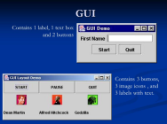

FSO ANALYTICS Tool – Example 2
Repeated Analysis
Pre & Post Analysis
Aids in doing comparison of same parameters month on month
Easy option to fetch reports
Aids in doing comparison of same parameters across different customer/regions
Ease of performing repeated analysis weekly/monthly, on the same parameters, for same customer
Based on actions identified from analysis, results to be monitored
To support in performing the RCA for problematic areas identified through analysis, tool provides the feature of creating & downloading reports
Highlighting Key Insights based on Analysis
Key highlights & Lowlights from data depicted as textual & tabular insights in the tool
Aids in identifying key improvement areas in order to improve FTR & Incoming WO Quality
WFM Closure Dump
FSO Analytics History DB
Data Aggregation
Analytics GUI Representation
Analysis Procedures Execution

Slide 25
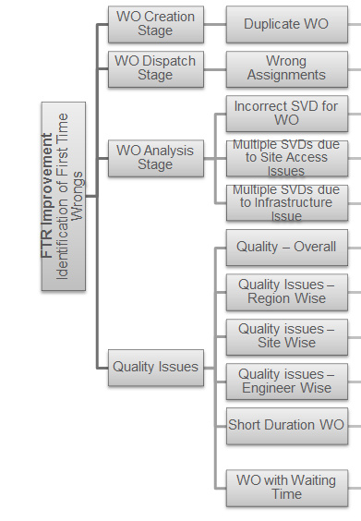
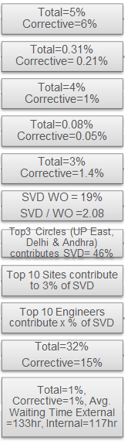
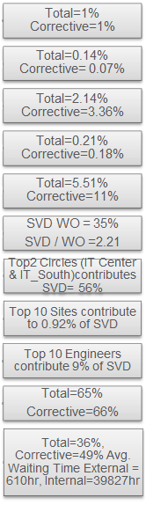
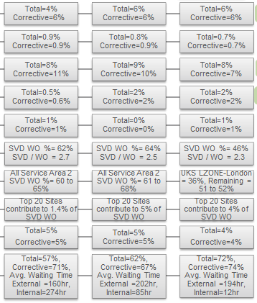
UC1 FTR Improvement ANALYSIS FRAMEWORK
3M(Jun to Aug16)
12M(Sep 15-Aug16)
5M (Aug - Dec16)
RWCE
RCOM (RINA)
Vfe Italy (RMED)
MBNL
TELEFONICA
VGC

Slide 26
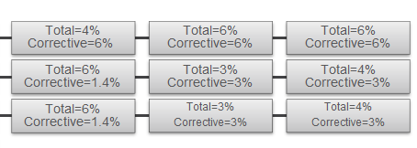
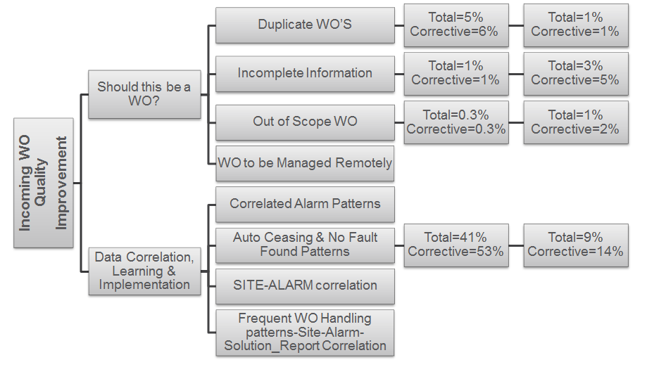

UC2 INCOMING WO QUALITY data# rcom: Jun-Aug’16, Vfe Italy: Sep15 – Aug’16
3M(Jun to Aug16)
12M(Sep 15-Aug16)
5M (Aug - Dec16)
RWCE
RCOM (RINA)
VFE Italy(RMED)
MBNL
TELEFONICA
VGC

Slide 27
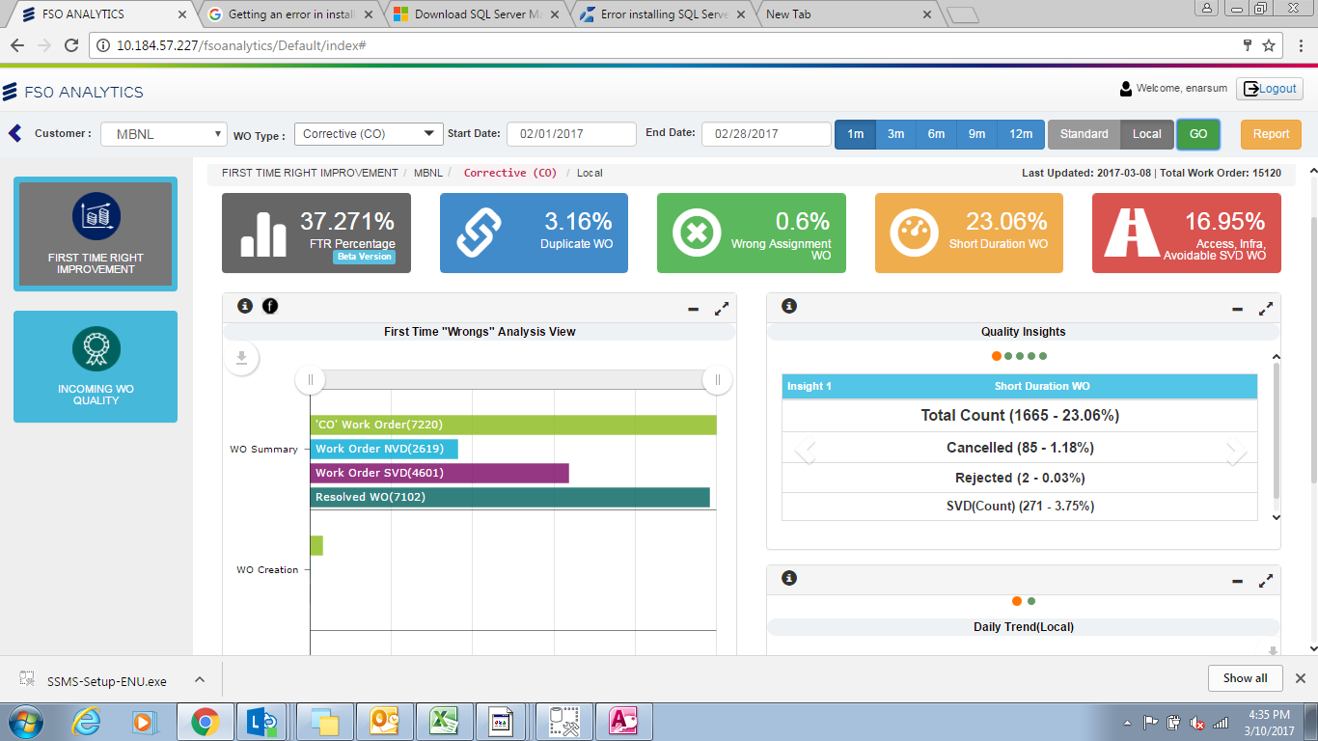
Dashboard

Slide 28
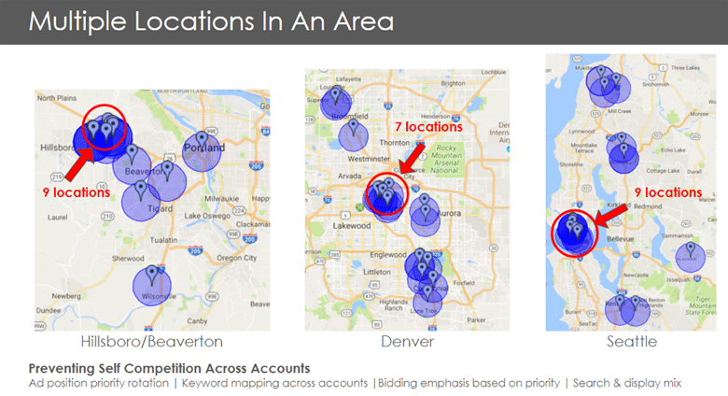
More Examples
This example clearly highlights to a company with multiple business locations how their targeting overlaps across their different locations. This is important to the business owner because targeting overlapping locations in search campaigns can cause cannibalization of data and self-competition. As a result, this may drive up costs and hurt the ability to optimize each campaign. We used the above map as a visual tool to demonstrate the proliferation of the problem and identify exactly which areas needed to be addressed. We found this to be more impactful and clear when explaining our reasoning for implementing the strategies listed at the bottom of the slide.

Slide 29
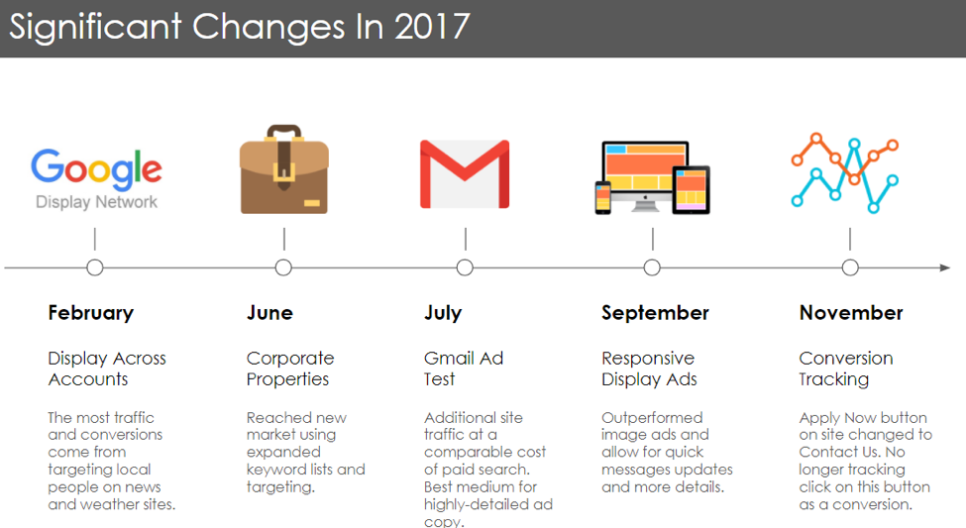
More Examples contd..
This type of information for a client report could have easily been distributed in a laundry list of bullets, but instead, it’s presented as a crisp, clean timeline. This format gets rid of the noise and makes it easier to understand how different initiatives impacted the business and online campaigns at different points in the year. This type of context, enabled by the linear demonstration and concise text, shows the evolution of the story.

Slide 30
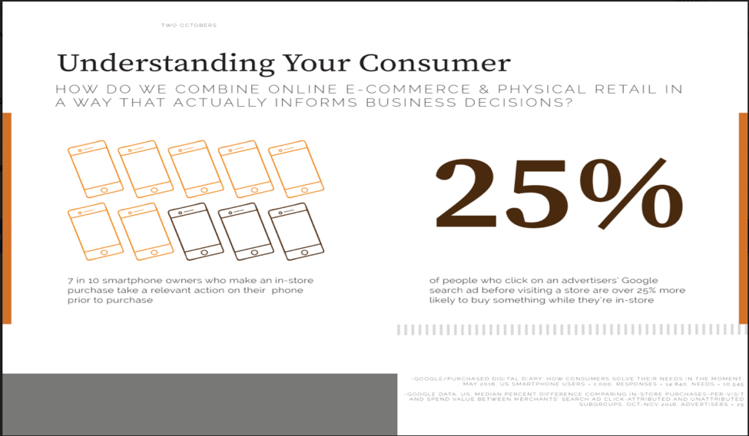
More Examples contd..
End With an Insight
This particular example was part of a presentation illustrating the importance of tracking in-store visits. Many of our clients, and many business owners in general, struggle to merge online and offline data to create a complete picture of their consumers. Being able to explore how users discover the brand, how they stay engaged, and what leads them to finally take action can be invaluable information to have.

Slide 31
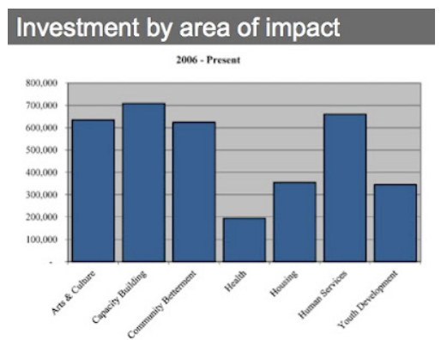
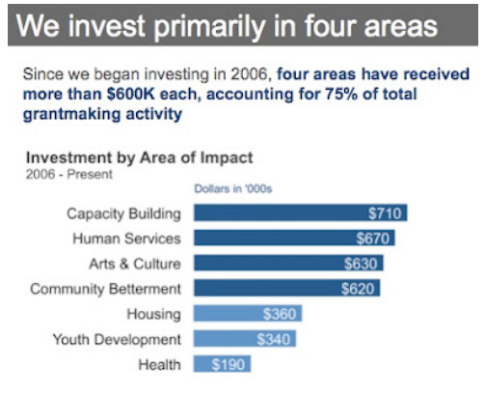
More Examples contd..
A simple story
… this tells a better story

Slide 32
Case Studies
Specifically, we’ll discuss:
Color considerations with a dark background
Leveraging animation in the visuals you present
Establishing logic in order
Strategies for avoiding the spaghetti graph
Alternatives to pie charts

Slide 33
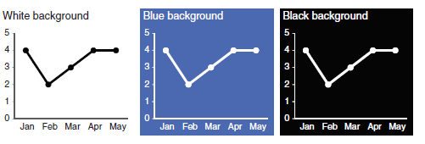
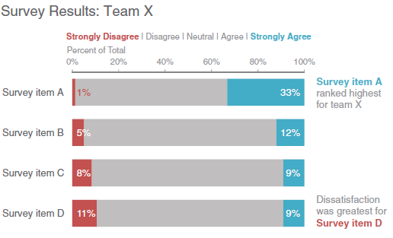
CASE STUDY 1: Color considerations with a dark background
When it comes to communicating data, won’t typically recommend anything other than a white background. With the white background, I find it easy to focus on the data.
That said, sometimes there are considerations outside of the ideal scenario for communicating with data that must be taken into account, such as your company or client’s brand and corresponding standard template.

Slide 34
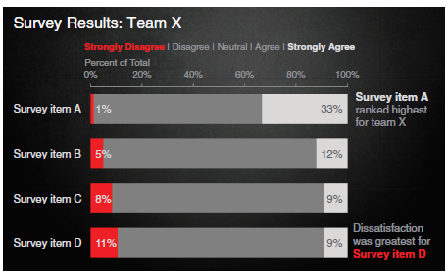
CASE STUDY 1: Color considerations with a dark background
In an endeavor to create something more in sync with the client’s brand, leveraging the same dark background. With a white background, the further a color is from white, the more it will stand out (so grey stands out less, whereas black stands out very much). With a black background, the same is true, but black becomes the baseline (so grey stands out less, and white stands out very much). Some colors that are typically verboten with a white background (for example, yellow) are
against black (didn’t use yellow in this particular example but did in some others).
incredibly attention grabbing

Slide 35
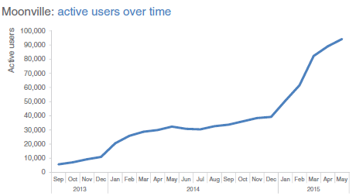
CASE STUDY 2: Leveraging animation in the visuals you present
Let’s assume that you work for a company that makes online social games. You are interested in telling the story around how active users for a given game—let’s call it Moonville—have grown over time.
The challenge, however, is that when you put this much data in front of your audience, you lose control over their attention.

Slide 36
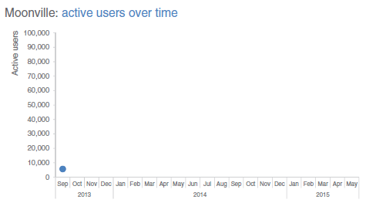
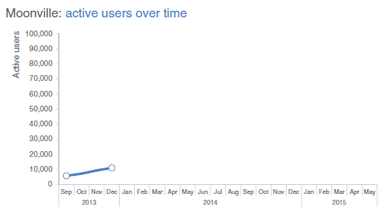
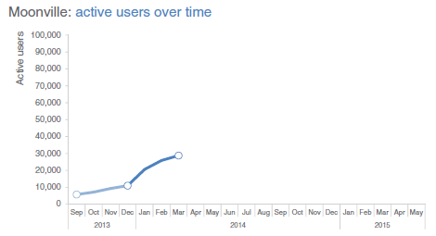
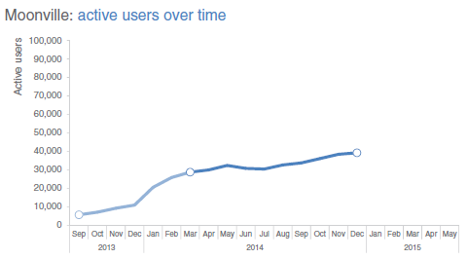
CASE STUDY 2: Leveraging animation in the visuals you present
Tell story like this …
Early feedback on the game was mixed. In spite of this—and our practically complete lack of marketing—the number of active users nearly doubled in the first four months, to almost 11,000 active users by the end of December.
In early 2014, the number of active users increased along a steeper trajectory. This was primarily the result of the friends and family promotions we ran during this time to increase awareness of the game.
Growth was pretty flat over the rest of 2014 as we halted all marketing efforts and focused on quality improvements to the game.

Slide 37
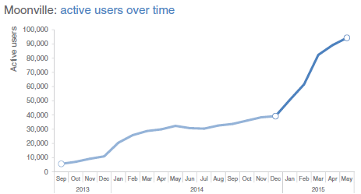
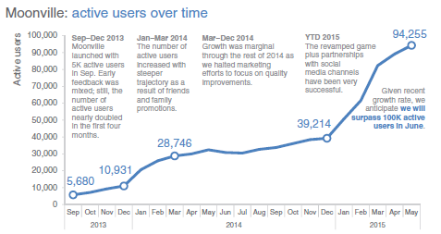
CASE STUDY 2: Leveraging animation in the visuals you present
Uptake in 2015, on the other hand, has been incredible, surpassing our expectations. The revamped and improved game has gone viral. The partnerships we’ve forged with social media channels have proven successful for continuing to increase our active user base. At recent growth rates, we anticipate we’ll surpass 100,000 active users in June!
For the more detailed version that you circulate as a follow up or for those who missed your (stellar) presentation, you can leverage a version that annotates the salient points of the story on the line graph directly,

Slide 38
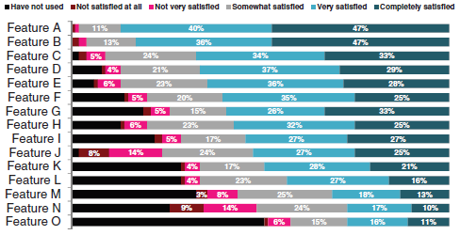
CASE STUDY 3: Logic in order
First, let’s set the context. Let’s say you work at a company that sells a product that has various features. You’ve recently surveyed your users to understand whether they are using each of the features and how satisfied they’ve been with them and want to put that data to use. The initial graph you create might look something like Figure below -

Slide 39
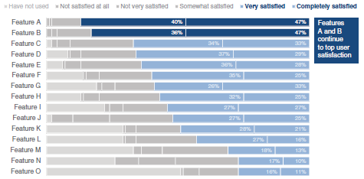
CASE STUDY 3: Logic in order
Contd..
User satisfaction varies greatly by feature
Features A and B continue to top user satisfaction

Slide 40
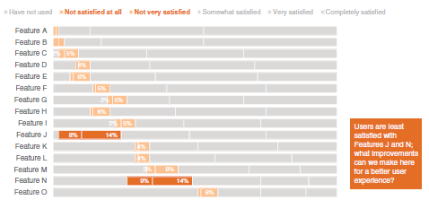
CASE STUDY 3: Logic in order
Contd..
This is followed by a focus on the other end of the spectrum to where users are least satisfied, again calling out and highlighting specific points of interest.
Features J and K are the features with which users are least satisfied.

Slide 41
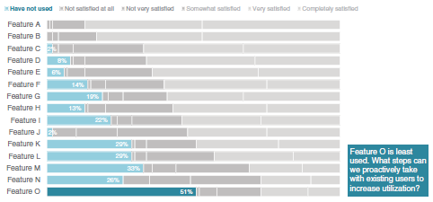
CASE STUDY 3: Logic in order
Contd..
Finally, preserving the same order, we can draw our audience’s attention to the unused features.
Feature O is the least used feature.

Slide 42
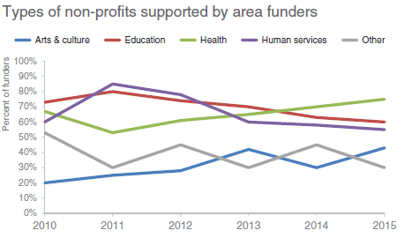
CASE STUDY 4: Strategies for avoiding the spaghetti graph
A spaghetti graph is a line graph where the lines overlap a lot, making it difficult to focus on a single series at a time. They look something like below-

Slide 43
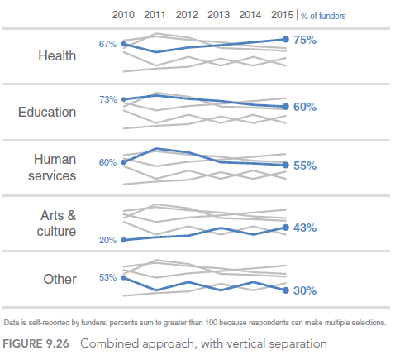
CASE STUDY 4: Strategies for avoiding the spaghetti graph
Types of non-profits supported by area funders

Slide 44
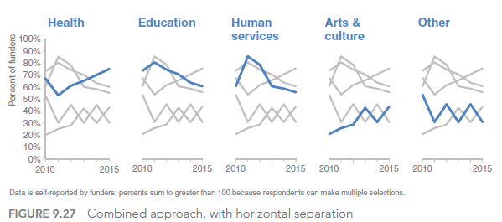
CASE STUDY 4: Strategies for avoiding the spaghetti graph

Slide 45
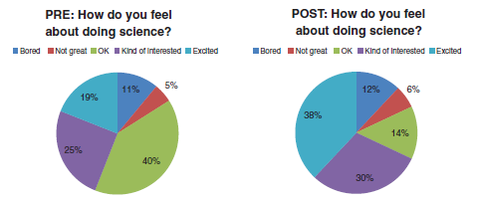
CASE STUDY 5: Alternatives to pies
Survey results: summer learning program on science

Slide 46

CASE STUDY 5: Alternatives to pies
Alternative #1: show the numbers directly

Slide 47

CASE STUDY 5: Alternatives to pies
Alternative #2: simple bar graph

Slide 48

CASE STUDY 5: Alternatives to pies
Alternative #3: 100% stacked horizontal bar graph

Slide 49

CASE STUDY 5: Alternatives to pies
Alternative #4: slopegraph

Slide 50
References
https://twooctobers.com/blog/8-data-storytelling-concepts-with-examples/
https://higherlogicdownload.s3.amazonaws.com/AMSTAT/62ac7e8c-c7ec-4e98-b58b-dd540bf9e0d9/UploadedImages/dvc2014/Veena%20MendirattaASA%20Storytelling%20with%20Data%20Visualization.pdf
https://www.slideshare.net/AndrsFortinoPEPhD/the-art-of-business-storytelling-with-data
https://www.slideshare.net/miriamgilbert08/data-stories-workshop-34390209
https://www.juiceanalytics.com/writing/the-ultimate-collection-of-data-storytelling-resources
https://www.lynda.com/Excel-tutorials/Data-Visualization-Storytelling-Essentials/435230-2.html
https://www.udemy.com/course/draft/874860/

